Slide 1
INSURANCE ANALYTICS PROJECT
MENTOR: Mahendra Singh
Group no: 2

Slide 2
Group members:
Saiprakash Raikar
Ganesh Kumbhar
Rutuja Draxe
Ravi Padamad
Prasad Merwade
Pratik Sonawale

Slide 3
Project objective
The project was based on the insurance domain. Aim was to prepare the dashboards to get new and renewal business numbers throughout the different branches..
Data was comprised of two datasets divided into 6 files one of it was csv and other 5 were excel files.
We tried to prepare dashboards of individual performance within the branch.
We Analysed the data and respectively prepared dashboards in Excel , Tableau & Power Bi. While preparing dashboards we gone through different calculations and fetched our data with the help of SQL.

Slide 4
KPI’S
No of Invoice by Account Executive
Yearly Meeting Count
Cross Sell--Target, Achieve, New
New-Target, Achieve, New
Renewal-Target, Achieve, new
Stage Funnel by Revenue
No of meeting By Account Executive
Top Open Opportunity

Slide 5
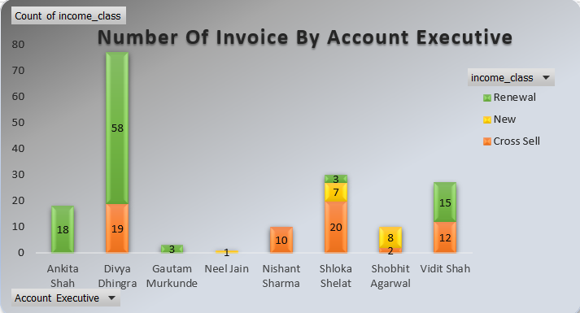
Kpi 1 : No. of invoice by account executive
The chart basically tells you the no. of invoices by different account executives.
The account executive Divya Dhingra had 77 invoices which are greater as compared to other executives.
As you see the income class renewal has higher no. of invoices throughout different income classes.

Slide 6
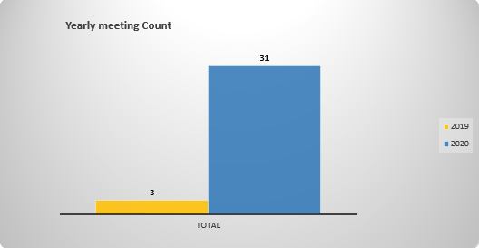
KPI 2: Yearly Meeting Count
From this columned bar chart you can find the no. of meetings.
The meetings were divided into 2 years.
Total no. of meetings are 34 from that 31 took place in year 2020 and remaining in year 2019.

Slide 7
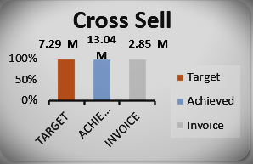
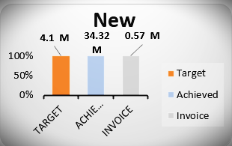
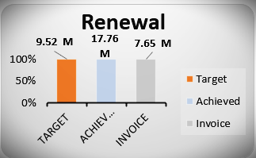
KPI 3: Cross sell , new & renewal..
Above three charts are visualizing the totals of Target , Achieve & Invoice in respective income classes.
The income class New generating revenue more than Cross Sell and Renewal class.
The column Achieved having larger total in all three categories throughout the income classes which is 65.12 M

Slide 8
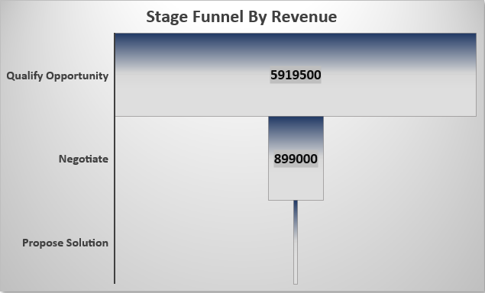
KPI 4: Stage funnel by revenue
The above chart displays the opportunity stages and their total revenue amount.
The stage Qualify Opportunity generating more revenue than negotiate and propose solution stages.

Slide 9
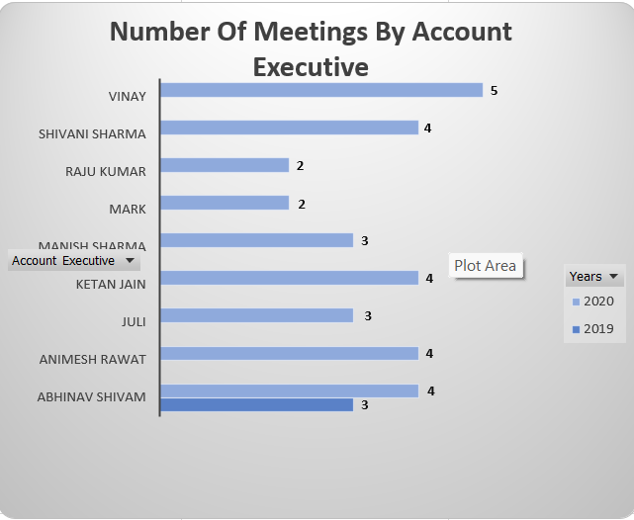
Kpi 5: No of meeting By Account Executive
The Following stacked column chart displays the no. of meetings by account executive.
The chart gives the no. of meetings which are held in 2 years.
In year 2019 31 meetings took place while in year 2020 3 meetings were held.
The account executive Vinay had taken more no. of meetings than by any other account executives.

Slide 10
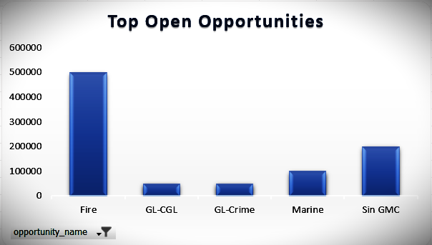
KPI 6: Top Open Opportunity
The chart displays the top open opportunities by revenue amount.
The opportunity Fire is generating more revenue than other following opportunities.

Slide 11
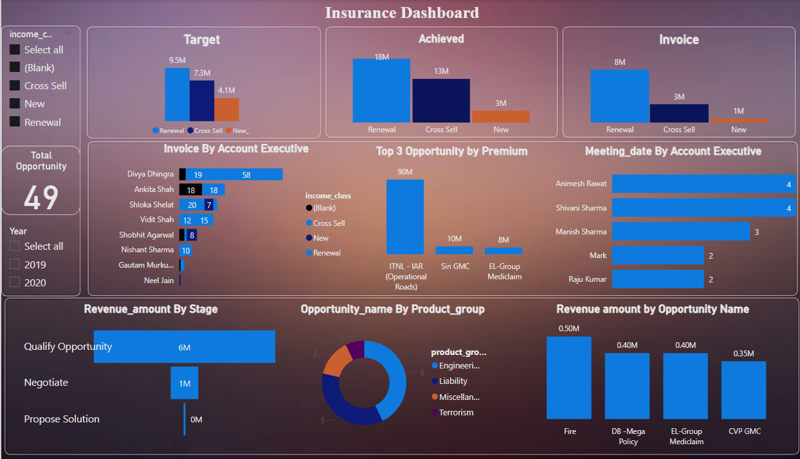
Final Dashboard (Power bi)

Slide 12


